Slide 1
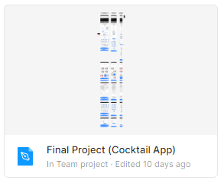

Wireframing using Figma.com
Consider the user experience and App flow on various screen sizes.
Use naming conventions, color theory, and other UX/UI aspects that can be replicated when coding.
Share the Board with fellow developers to work collectively.

Slide 2
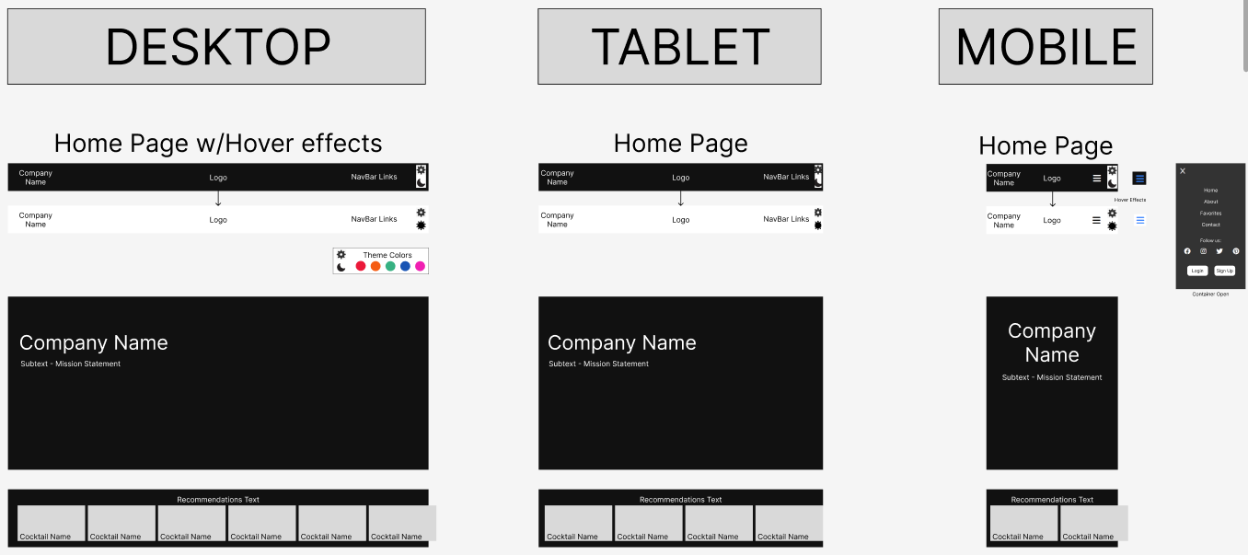

Slide 3
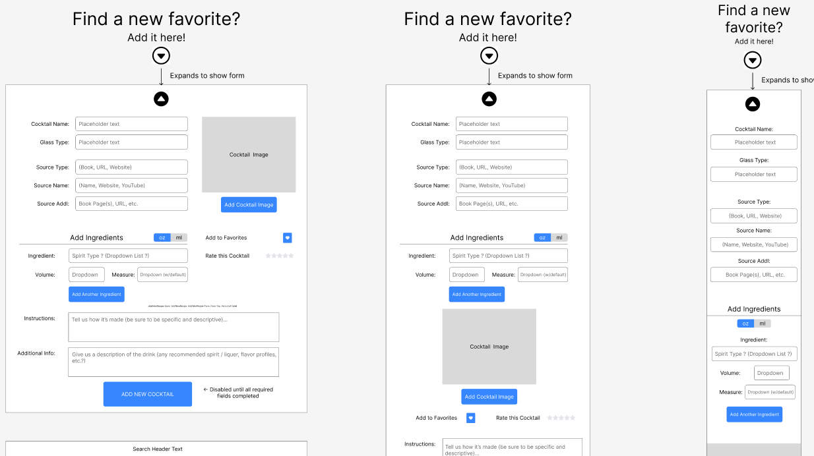

Slide 4
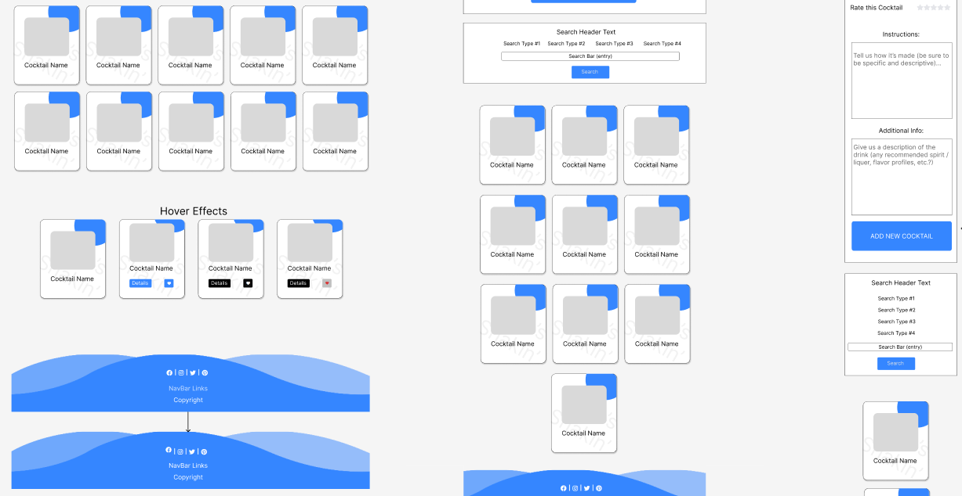

Slide 5
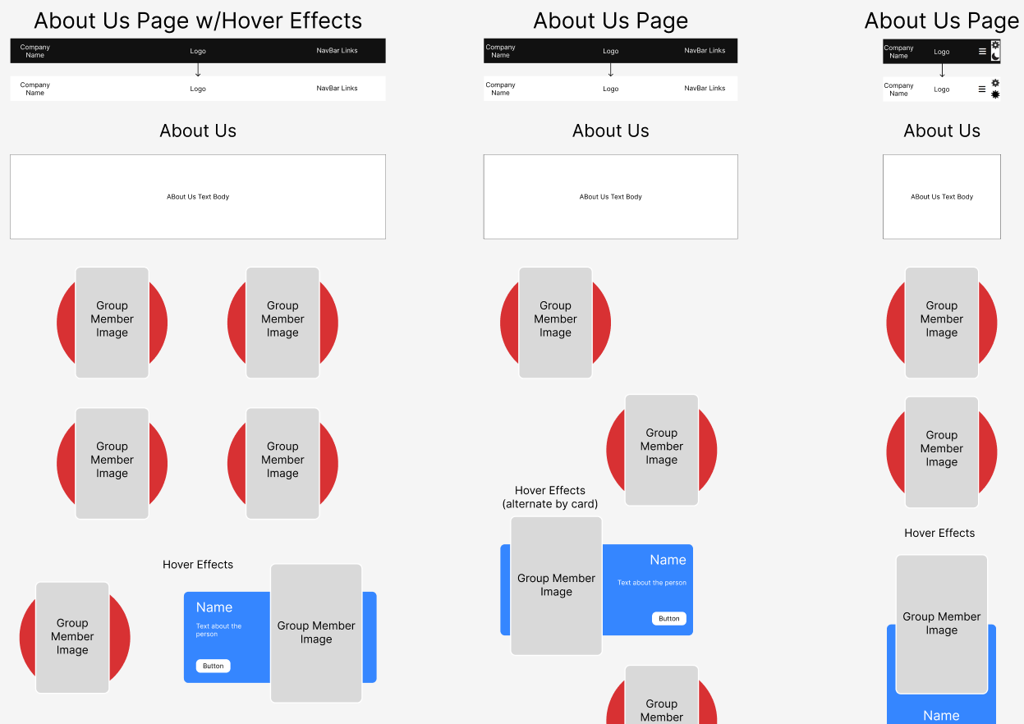

Slide 6
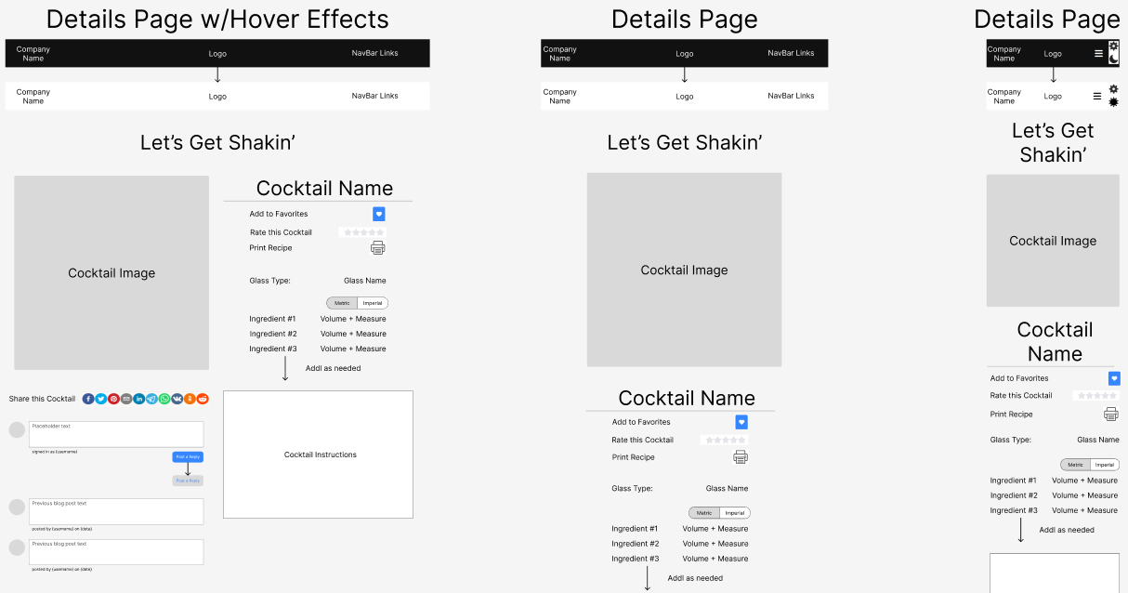

Slide 7
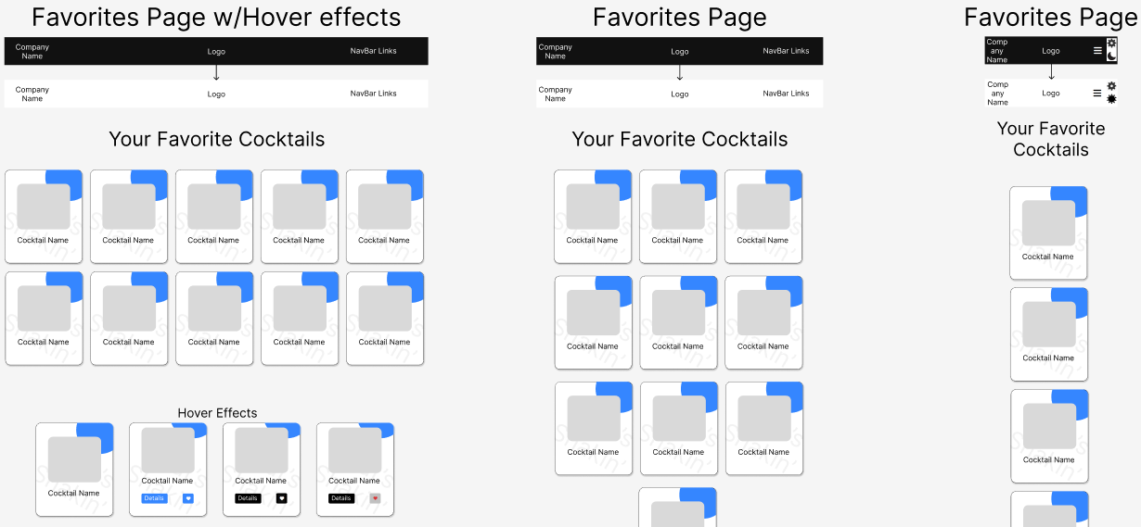

Slide 8
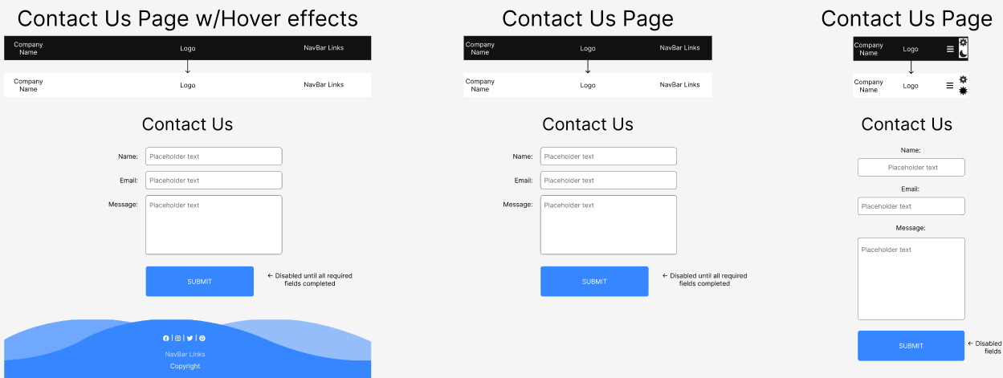

Slide 9

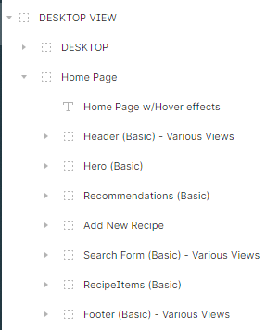
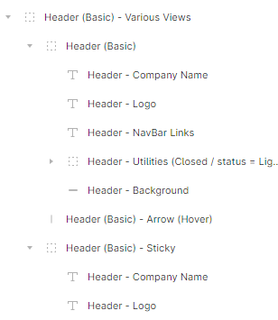
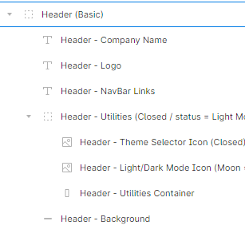
Each component broken down into granular detail and grouped with consistent naming conventions for clarity.

Slide 10
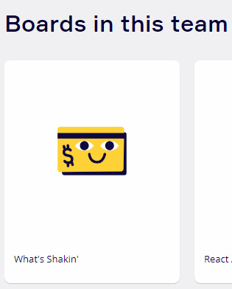

Flowchart design using Miro.com
Understand how different parts of the App connect to each other.
Determine the logic behind each action on a step-by-step basis.
Consider the user experience and App flow.
Share the Board with fellow developers to work collectively.

Slide 11
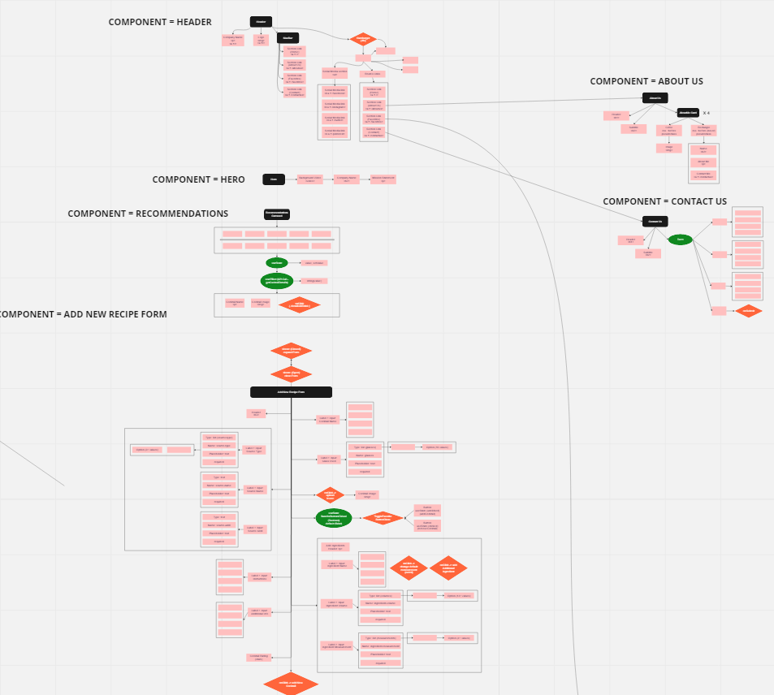

Slide 12
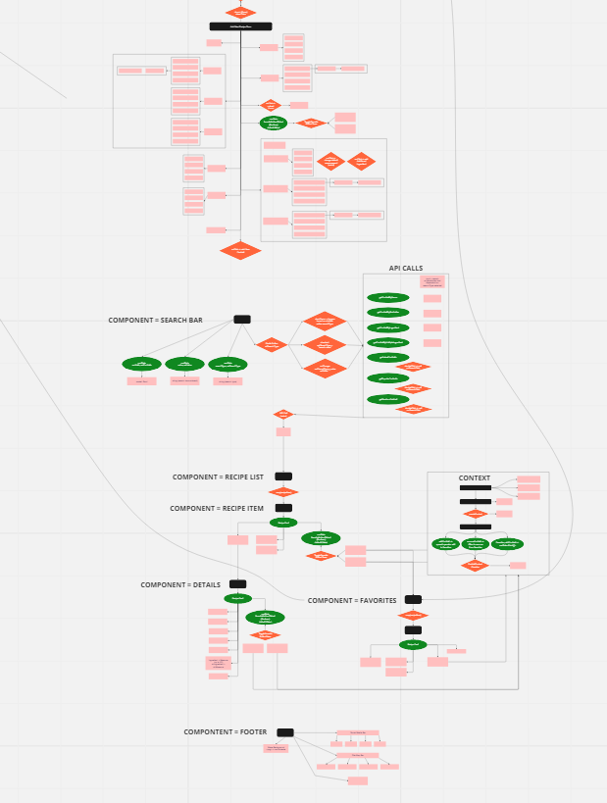

Slide 13
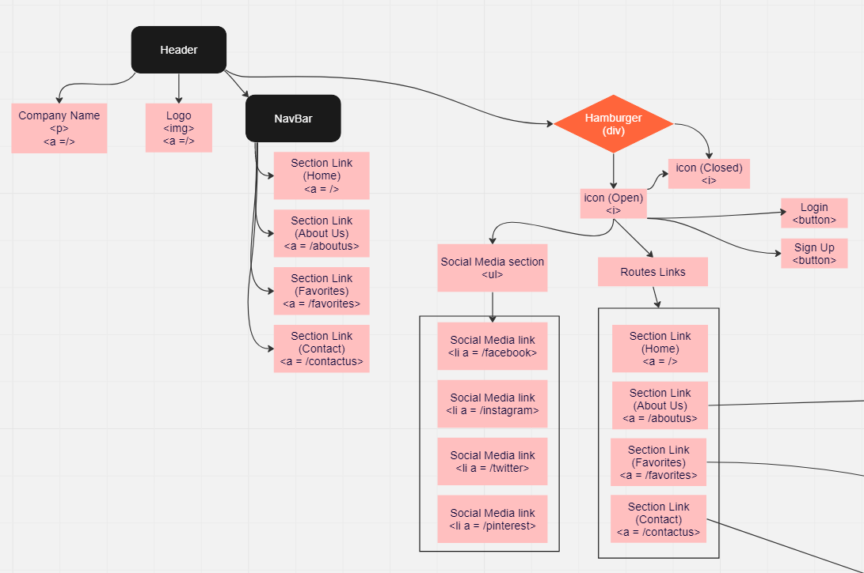

Slide 14
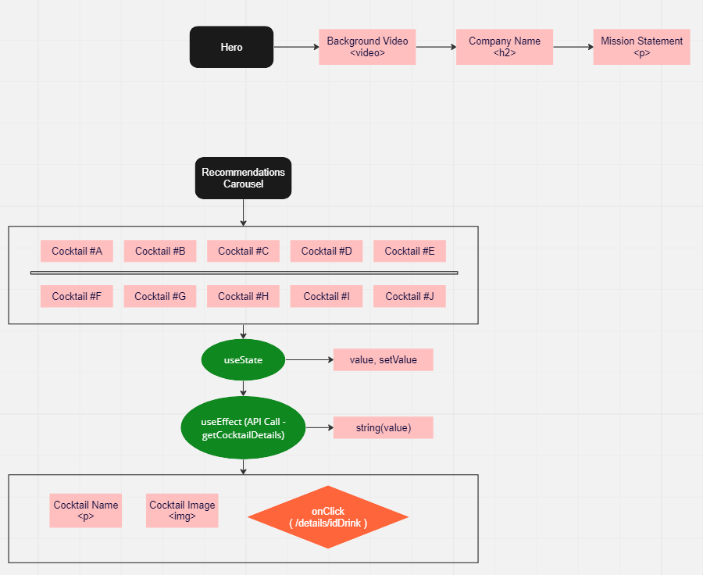

Slide 15
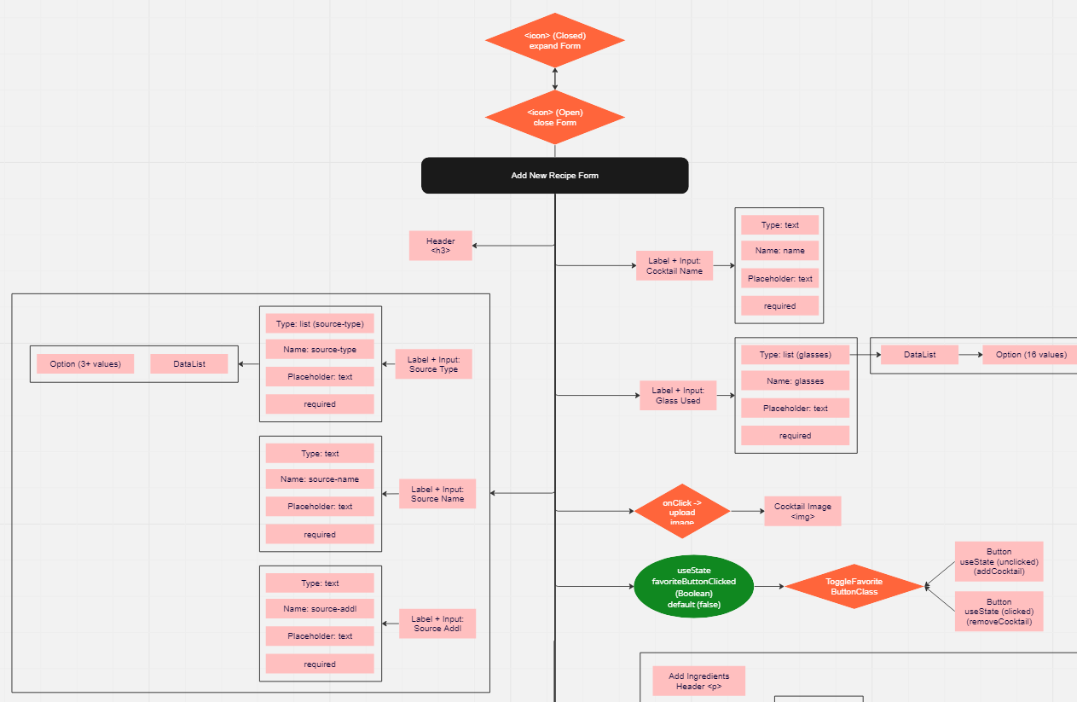

Slide 16
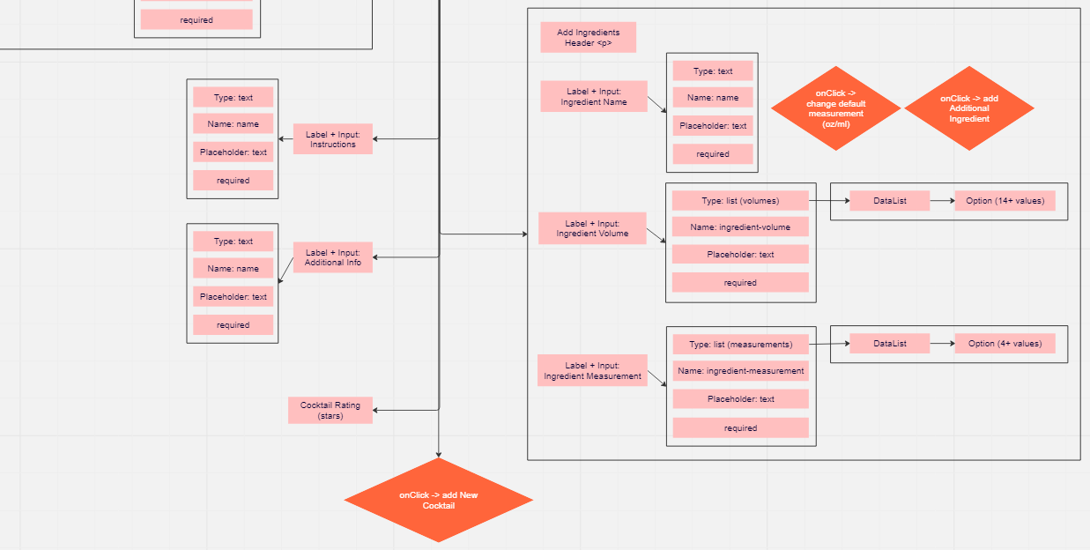

Slide 17
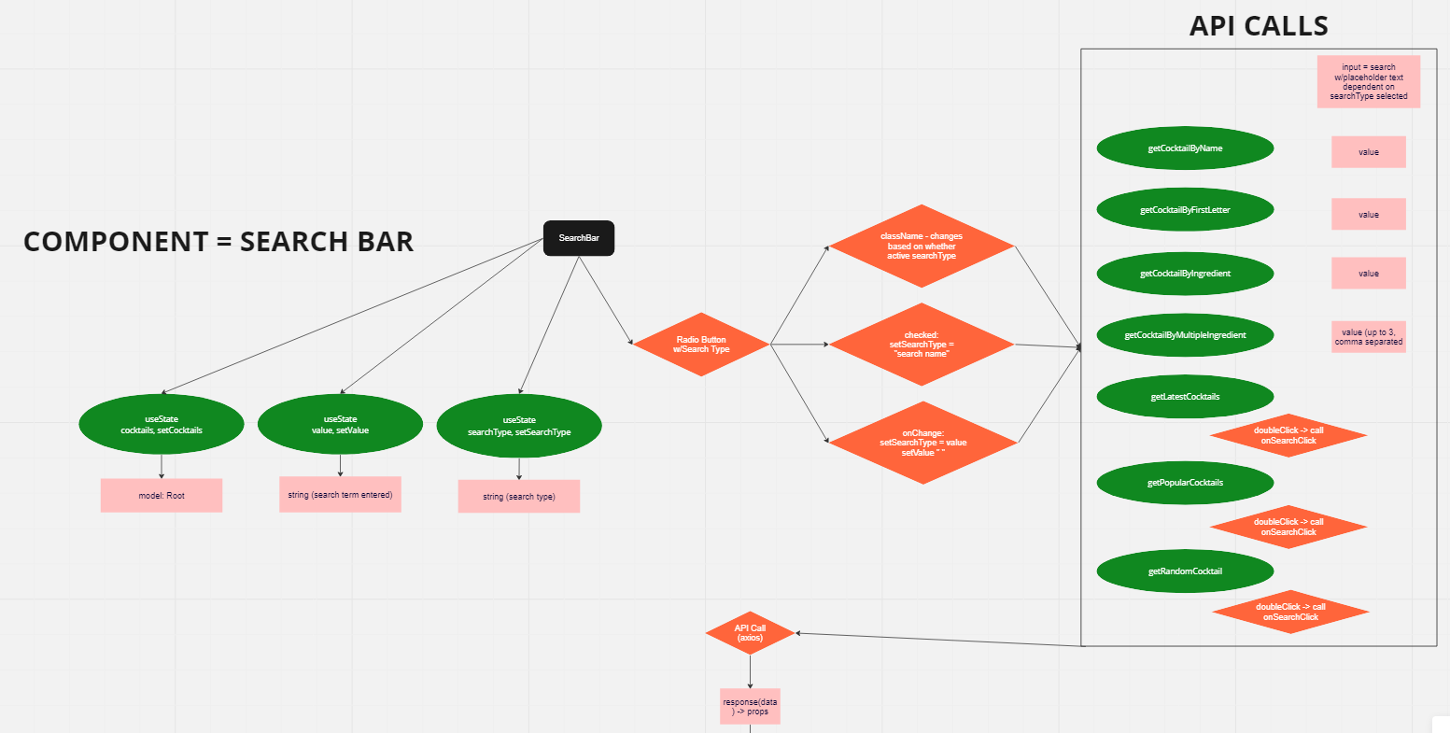

Slide 18
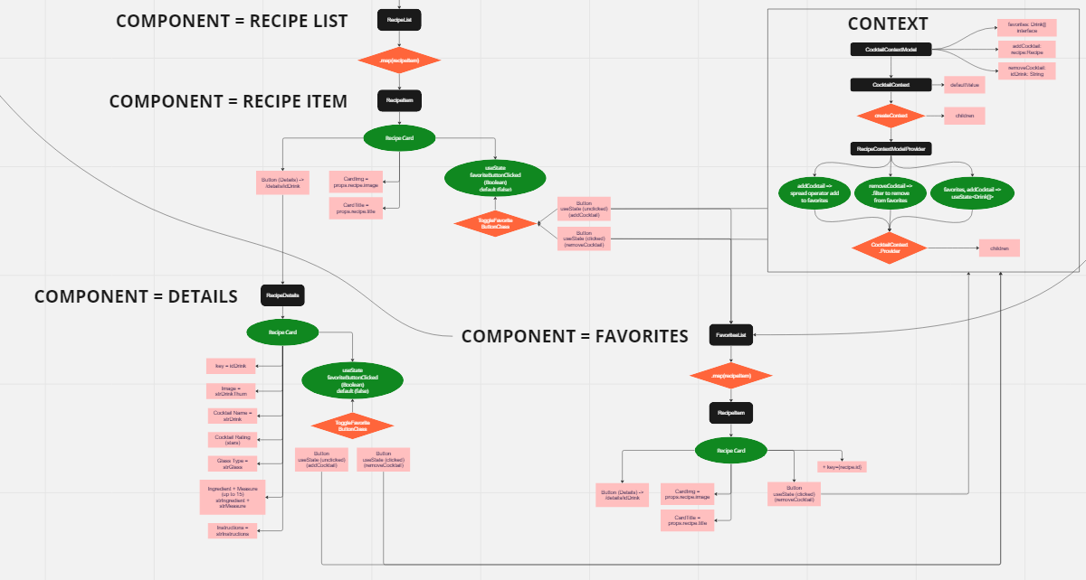

Slide 19


Slide 20
